Slide 1
System Design And Modelling
PRESENTED BY
GROUP 22

Slide 2
Outline
Introduction
System Design
System Modelling

Slide 3
1. Introduction
Our system design and modeling process involved grouping functionalities based on similarities in implementation and breaking them down into modules, each providing a specific set of functions.
This approach was used to come up with the system design and the system model using UML diagrams.

Slide 4
2. System Design
In coming up with the system design for instance, we grouped the Request for help and report disaster. Them we came up with the following modules:
Validation of Users Statement
Validate existence of location provided
Ensure contact info is correctly provided
Check disaster exists
Ensure video format is correct, size limits
Ensure description provided meets minimum length criteria
Verification and validation of user statement
Feedback based on authenticity

Slide 5
Choosing Architecture
In choosing our architecture, we mainly took into consideration the non-functional requirements, since the non-functional requirements will be directly affected by the architecture. We mainly considered the following:
Scalability
Performance
Offline Functionality
Based on this, we combined two architectures
- Client-sever Architecture
- Offline-first Architecture

Slide 6
Technologies
Considering the architecture and importance of the application, we chose to build a hybrid application using the following technologies:
Client: Ionic with ReactTs
Server: Node Js
Database: MongoDB

Slide 7
3. System Modelling
This is the process of creating diagrams and representations of a system to understand how it works and how its parts interact.
Context Diagram
Use Case Diagram
Sequence Diagram
Class Diagram
Deployment Diagram

Slide 8
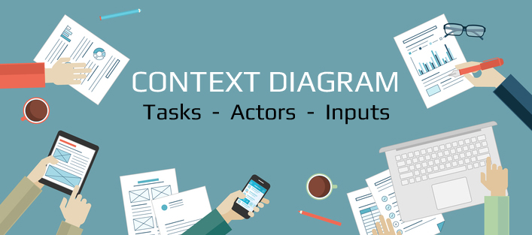
3.1 Context Diagram

Slide 9
3.1 Context Diagram
A context diagram is a high-level visual representation of a system and its interactions with external entities. Components of a context diagram include:
System
External Entities
Users
Authorities
External Services
Data Flows

Slide 10
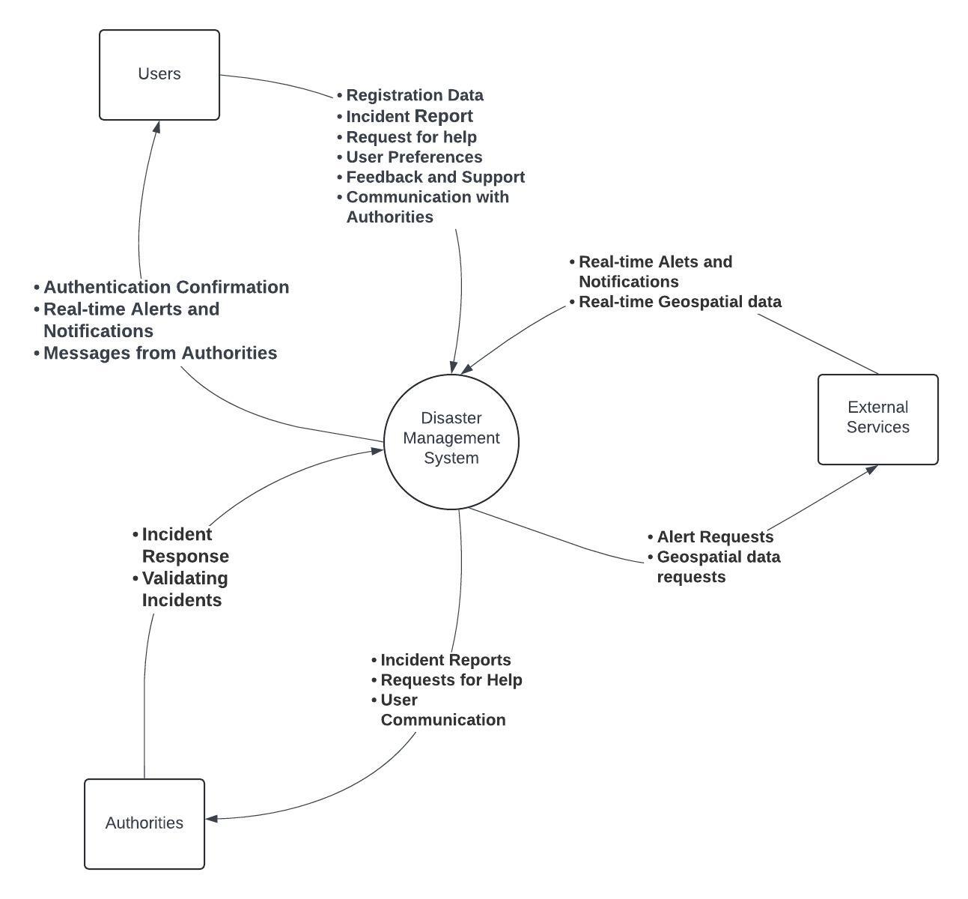

Slide 11
3.2 Use Case Diagram
A use case diagram is a graphical representation that depicts how users interact with a system and its functionalities.
Actors:
User
Emergency Responders
External APIs (Geospatial Data Provider

Slide 12
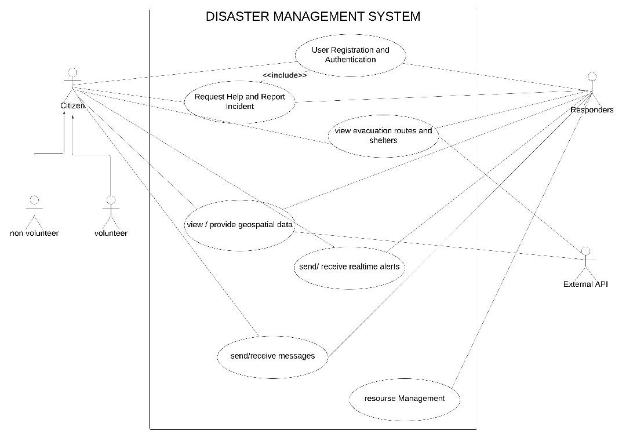

Slide 13
3.3 Sequence Diagram
A sequence diagram is a visual representation of the message flow between objects in a system, arranged in chronological order. It shows process interactions arranged in time sequence.
Report Disaster and Request For Help
Geospatial Data Integration

Slide 14
3.3.1 Report Disaster and Request for Help
This sequence diagram shows the steps involved in a user reporting a disaster event and requesting assistance during a disaster.
Objects
Disaster Management System
External System API
Media/Database

Slide 15
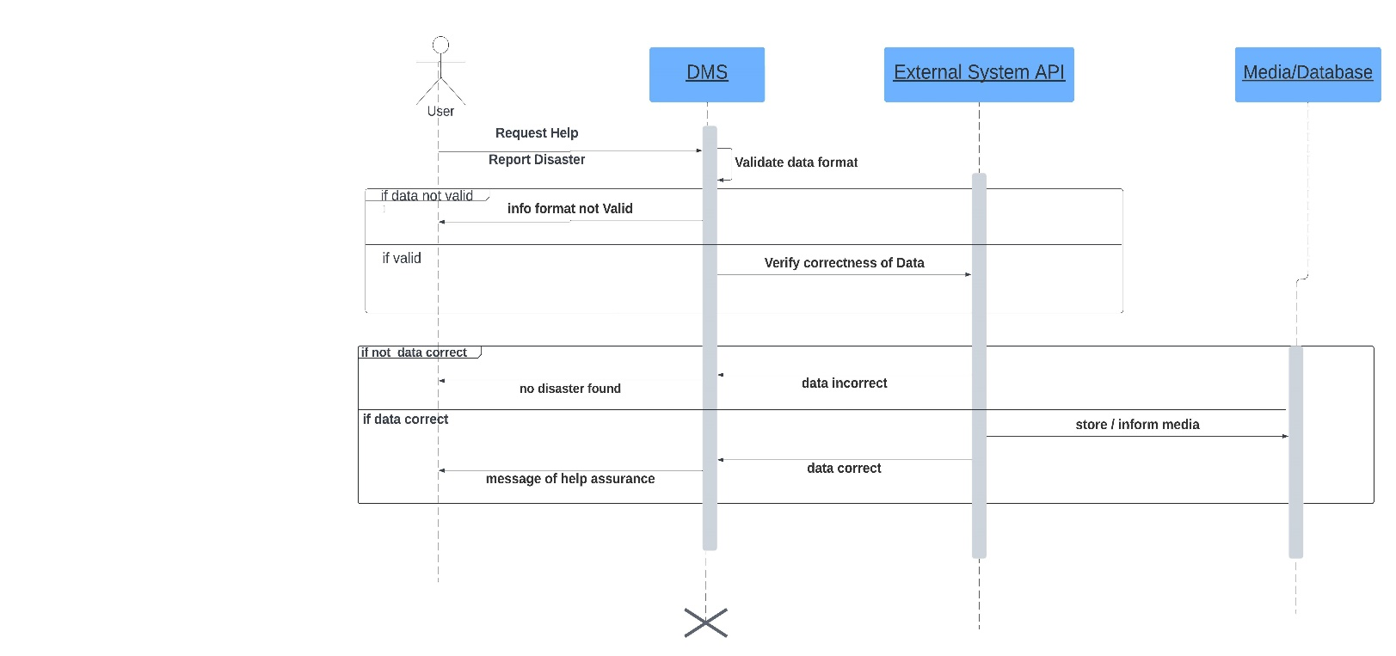

Slide 16
3.3.2 Geospatial Data Integration
This sequence diagram illustrates how the DMS retrieves and integrates geospatial data to enhance situational awareness during a disaster.
Objects:
Disaster Management System (DMS)
Geospatial Data Provider API
Geospatial Data Analytics Provider API and Evacuation Route Service Provider API (Optional
Mapping Service Provider API

Slide 17
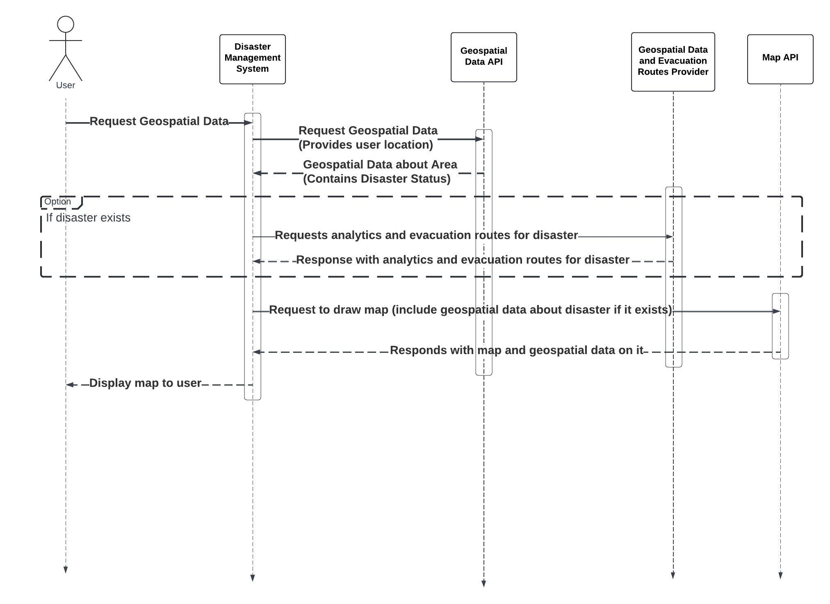

Slide 18
3.4 Class Diagram
The class diagram of our disaster management system shows the various classes their attributes, methods and relationship to other classes.

Slide 19
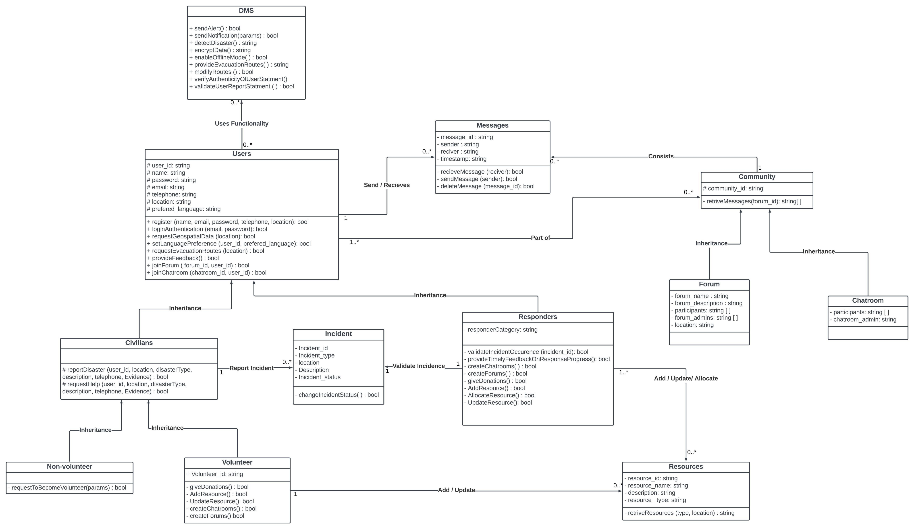

Slide 20
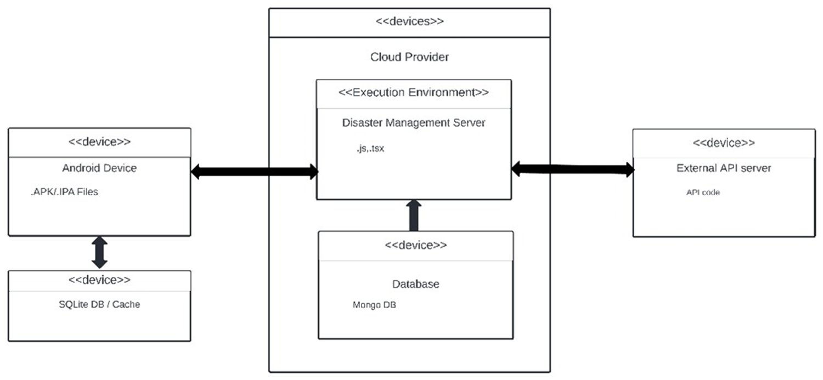
3.5 Deployment Diagram

Slide 21
THE END!!!

